Slide 1

Full Stack Project IT Service Desk
Built with Spring Boot, PostgreSQL, React... and more
Arthur MJ

Slide 2
Full Stack Project IT Service Desk
Built with Spring Boot, PostgreSQL, React... and more
Arthur MJ

Slide 3






Notes:
Imagine you have a large company

Slide 4
Notes:
And you are the CTO.

Slide 5
Notes:
You have the best staff

Slide 6
Notes:
The best internal support team

Slide 7





Notes:
But you have one problem!
You found yourself being the middle man between your staff and support team!
Very annoying!

Slide 8


Solution
Ticket System Platform
User
*Makes Ticket*
Support
*Handles Ticket*
*Accepts Ticket*
Notes:
The solution
You make an internal Ticket Handing System.
It will allow your staff to register their problems
And your support team to keep track of said problems
Skipping you (the CTO) !

Slide 9


Solution
Ticket System Platform
Admin
*Manages Users*
*Manages Assignments*
User
*Makes Ticket*
Support
*Handles Ticket*
*Accepts Ticket*
*Solution via Comments*
Notes:
On top of said feature.
You want to extend the system with
some basic user management.
comments and status updates
assignment management

Slide 10
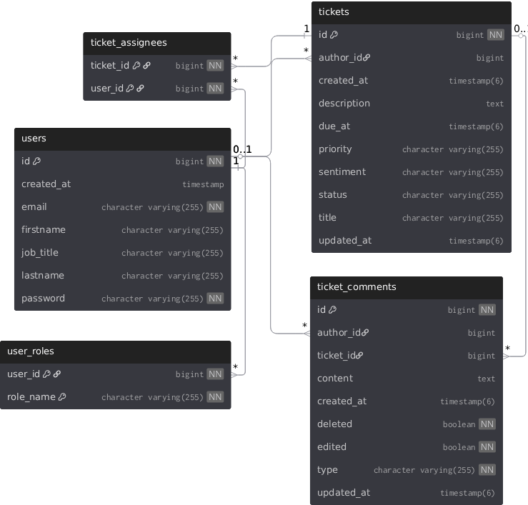
Database architecture
users
Authentication, Profile
roles
Permissions
Notes:
The database plan.

Slide 11
users
Authentication, Profile
roles
Permissions
Notes:
Basic Tables for Authentication and Profiles
Basic roles collection table

Slide 12
users
Authentication, Profile
roles
Permissions
Notes:
Ticket information table
Many-to-many table for assignments

Slide 13
users
Authentication & Permissions
addresses
Multiple addresses per user
Notes:
Ticket comments table

Slide 14
Database architecture
users
Authentication & Permissions
addresses
Multiple addresses per user

Slide 15
Tech Stack
Backend
Spring Boot
PostgreSQL
Frontend
React
React-Router-DOM
Shadcn/ui
Lucide Icons
RadixUI
TailwindCSS
TypeScript
com.google.genai
habarta.typescript-generator
Notes:
Tech stack.
Basic spring boot setup
Basic react setup with shadcn/ui etc.
Quality-of-life backend package to generate typescript types and enums
Googles genai sdk

Slide 16
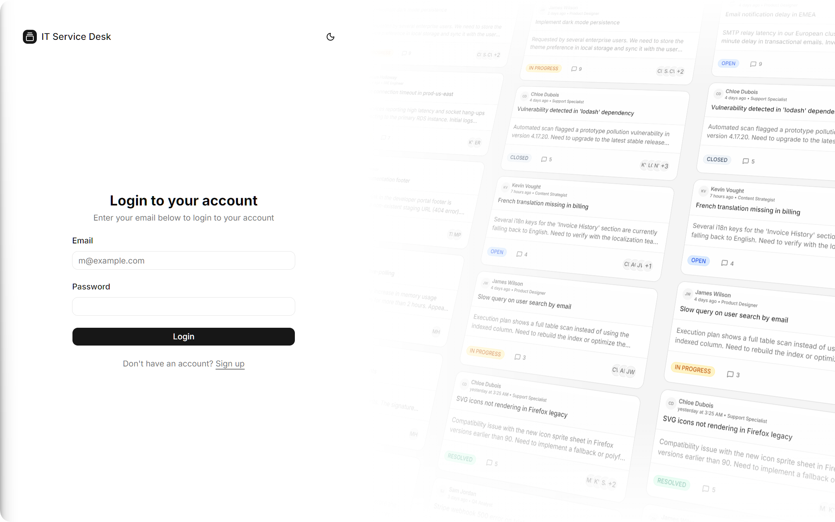
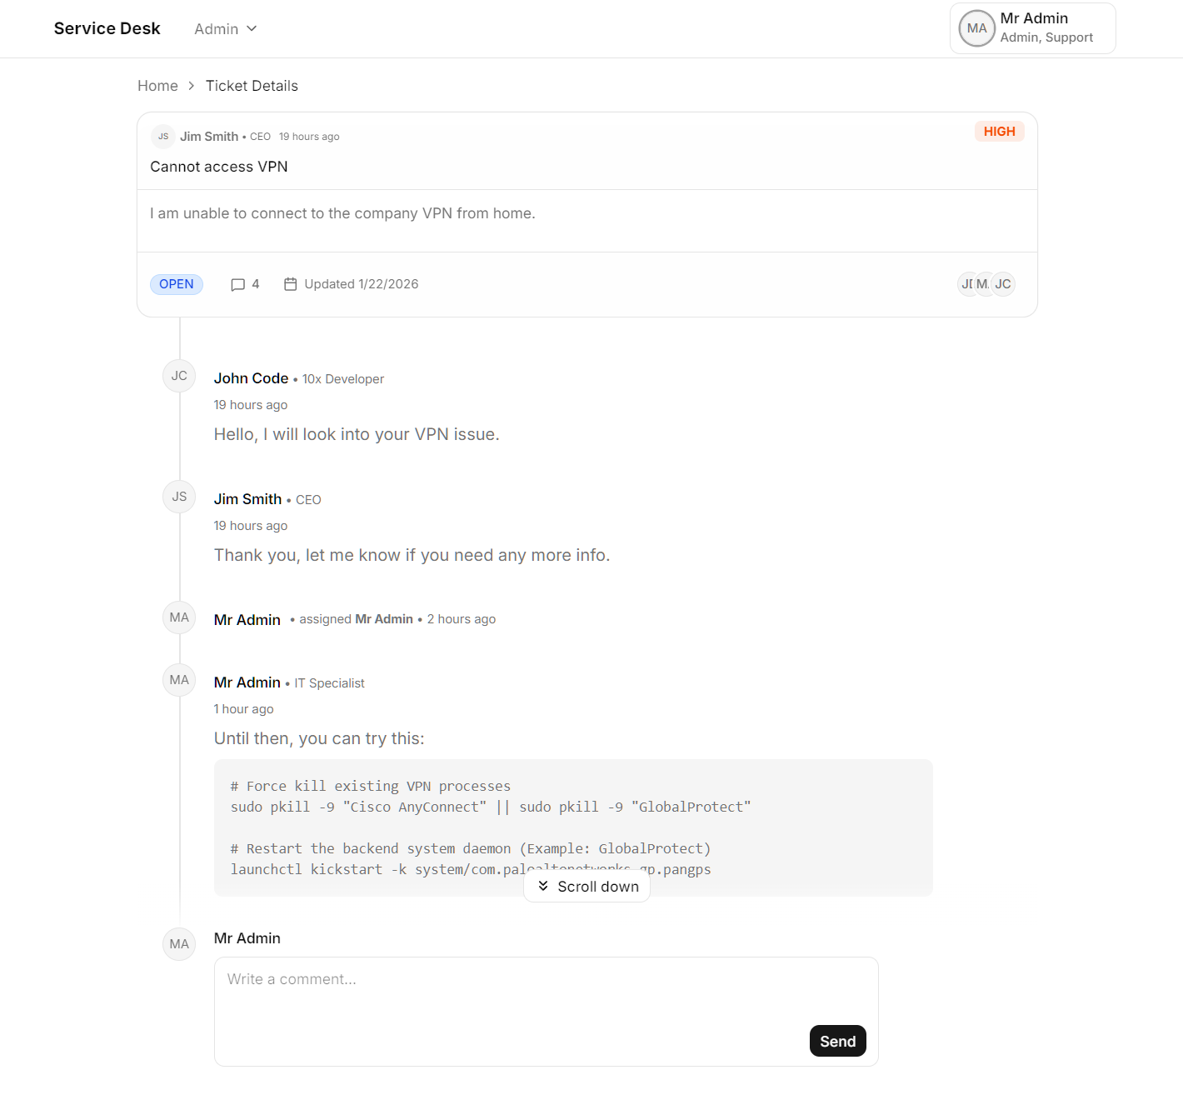
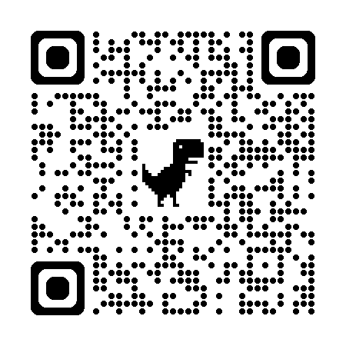
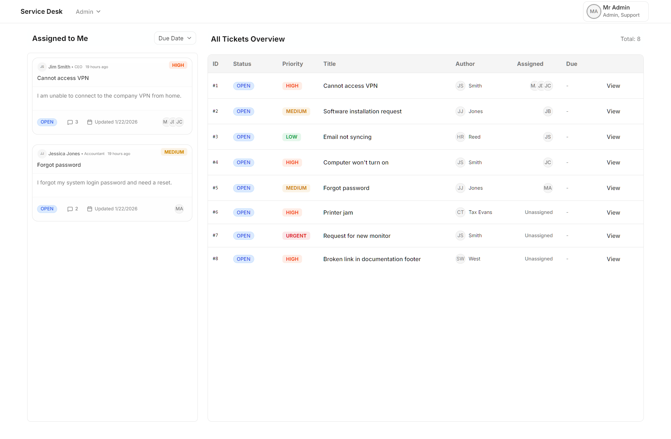
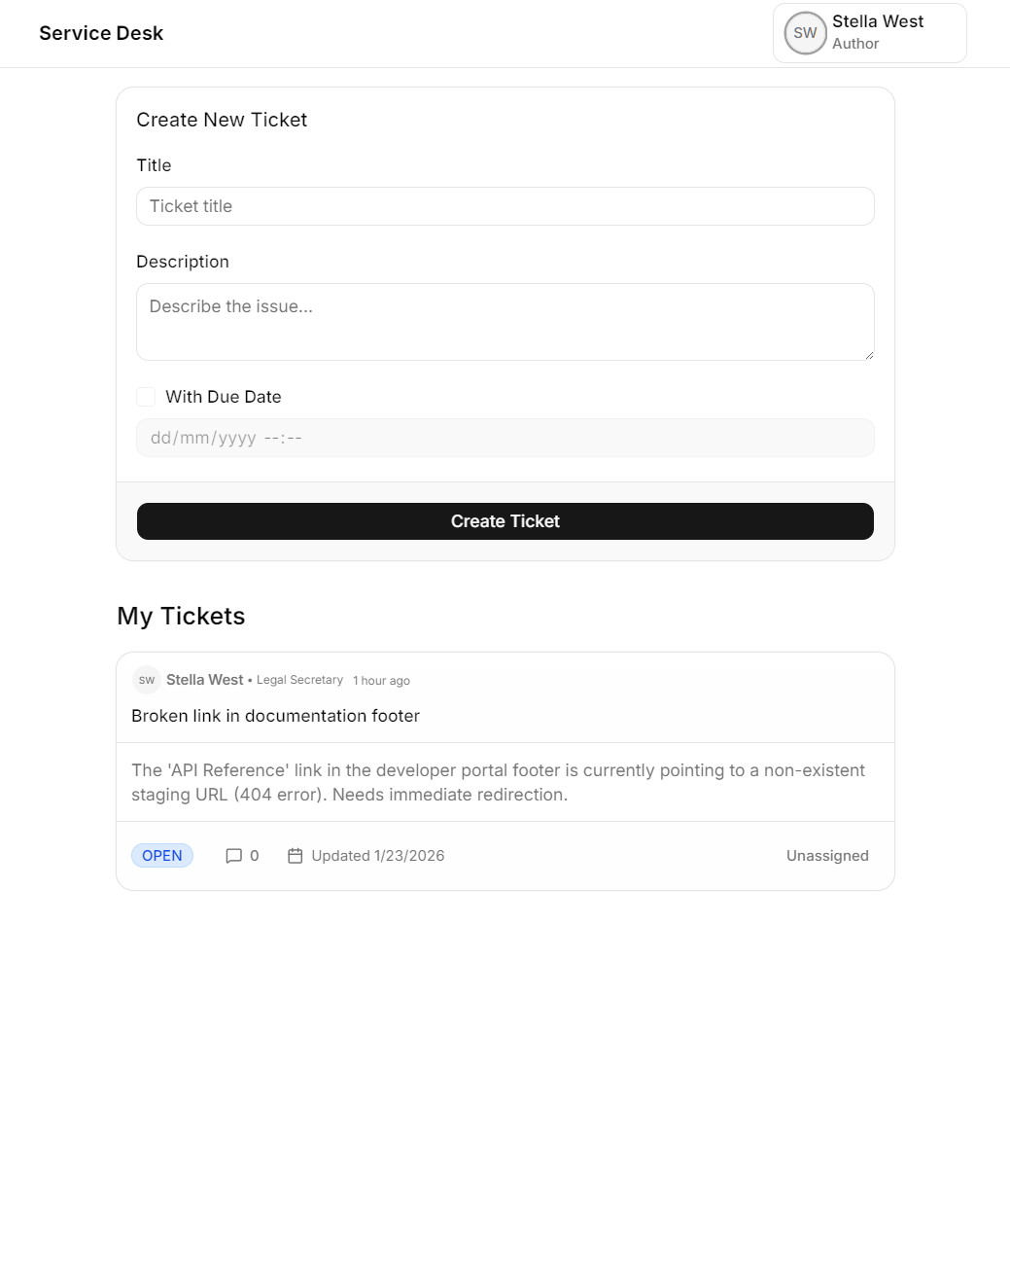
Live Demo
cnfpc2.fakedevs.com
Notes:
Demo
Show ticket creation from AUTHOR perspective
Show ticket accepting, commenting etc. from SUPPORT perspective
Show user management etc. from ADMIN perspective

Slide 17
Questions?

Slide 18
Thanks

